Slide 1
Day 5
Use Cases –
Learn Attack Pattern
Data Sources
Log analysis
Rule Writing

Slide 2
Security device concepts
Firewall
Proxy / Forward proxy
WAF (Web application firewall) – application level attack
Antivirus software's
EDR
Authentication devices (AAA) – Radius / TACACS+
PAM
IDS / IPS
Sandboxes
DLP
CASB
Email gateway appliances
IOT
Cloud endpoints
OS logs
Home work : Vendors

Slide 3
Use Case 1
Use Case | Data exfiltration
Rule | Potential data ex-filtration attempt through proxy
Description | When attacker / insider try to exfiltrate the data
Threat Indicator | Abnormal traffice - This rule detects if 1GB transfer in a single HTTP request using proxy and raise the incident for investigation.
Data Source to investigate | Here this rule can be applied to several data sources like Symantec bluecoat, cisco IronPort, etc.
Possible Actions | Terminat Connection - contact user or his Manager
Analyst Tips & Tricks | Check the IP associated with this. Check the log activity done by this IP as source IP Identify the user name / AD user name Contact the user via mail/phone or inform his manager using the organization chart Escalate to L2 / CIRT for further investigation if analysts feel severity is high/insufficient information.

Slide 4
Use Case 2
Use Case | Data exfiltration
Rule | Potential data ex-filtration attempt through email
Description | This rule detects if >15 MB transfer in a mail attachment using email and raise the incident for investigation.
Threat Indicator | The leak of sensitive data that might lead the cyber attack in the future or violation of policy/compliance.
Data Source to investigate | Email gateway appliance
Analyst Tips & Tricks | Check the Sender email address & Check associated user with email Check recipient email address Check the attachment contents and file Contact the user via mail/phone or inform his manager using the organization chart Escalate to L2 / CIRT for further investigation is analysts feel severity is high/insufficient information.

Slide 5
Use Case 4
Use Case | Suspicious Activity
Rule | Audit log cleared on windows system
Description | Audit log cleared on windows system
Threat Indicator | Violation of SOX compliance.
Data Source to investigate | Windows OS logs
Possible Actions | Suspend account or contact user or his Manager
Analyst Tips & Tricks | Check the Client User Name / Account Name associated with this. Identify the user name / AD user name. Contact the User and his / her manager and ask for justification. Contact the user via mail/phone or inform his manager using the organization chart Escalate to L2 / CIRT for further investigation, if analysts feel severity is high/insufficient information. Maybe CIRT will suspend the account until further clarity. Normally CIRT also works for 8 hours but there is somebody always available if needed called Watch duty.
517 : https://www.ultimatewindowssecurity.com/securitylog/encyclopedia/event.aspx?eventid=517
1102 : https://www.ultimatewindowssecurity.com/securitylog/encyclopedia/event.aspx?eventid=1102

Slide 6
Use Case 5
Use Case | Suspicious Activity
Rule | Password Changed by other than Windows Administrator / Account Owner
Description | Normally Account password is changed by the account owner. But if it reach to an expired period of account password (due to employee on vacation or any other reason), then the employee may request to windows Admin via ticket or call to reset the password.
Threat Indicator | Theft Identity and lateral moments – may harm to the organization.
Data Source to investigate | Windows OS logs
Possible Actions | Suspend account or contact user or his Manager
Analyst Tips & Tricks | Check the subject Username & target username associated with this. Contact the User and his / her manager and ask for justification. Identify the user name / AD user name Contact the user via mail/phone or inform his manager using the organization chart Escalate to L2 / CIRT for further investigation is analysts feel severity is high/insufficient information. Maybe CIRT will suspend the account until further clarity. Normally CIRT also works for 8 hours but there is somebody always available if needed called Watch duty.

Slide 7
Use Case 6
Use Case | Suspicious Activity – Watch list level use case
Rule | Unauthorized access to business server / DMZ server account
Description | Create Whitelist of allowed user list OR Create blacklist userlist But my suggestion is create whitelist which has less data & use this data in Qradar Rules
Threat Indicator | May harm to the organization.
Data Source to investigate | Auth Events for DMZ server
Analyst Tips & Tricks | Check the subject Username & target username associated with this. Contact the User and his / her manager and ask for justification. Identify the user name / AD user name Contact the user via mail/phone or inform his manager using the organization chart Escalate to L2 / CIRT for further investigation is analysts feel severity is high/insufficient information. Maybe CIRT will suspend the account until further clarity. Normally CIRT also works for 8 hours but there is somebody always available if needed called Watch duty.

Slide 8
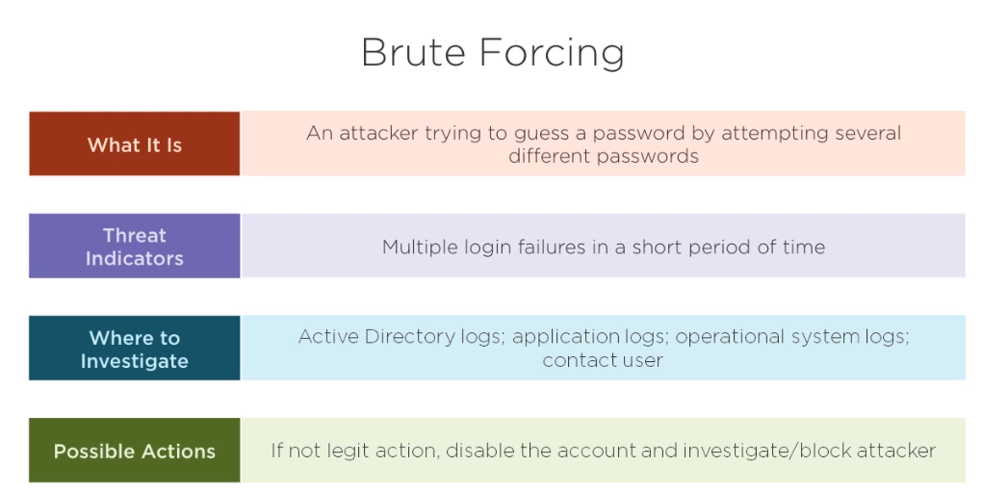

Slide 9
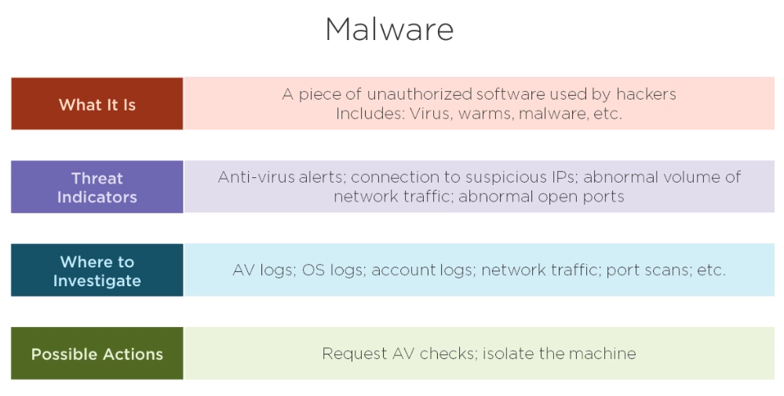

Slide 10
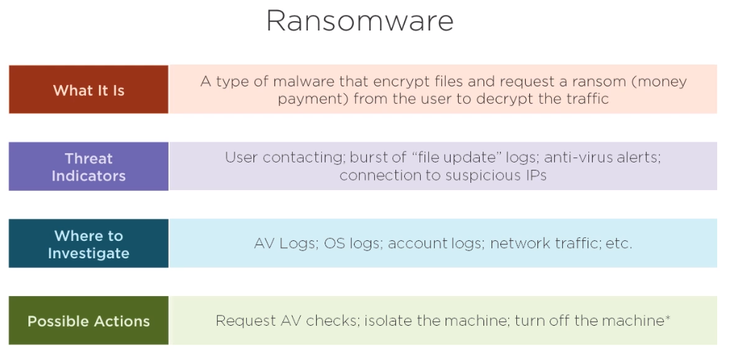

Slide 11
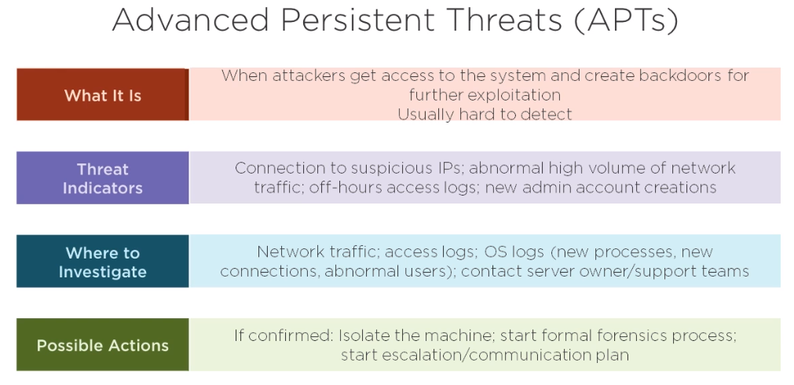

Slide 12
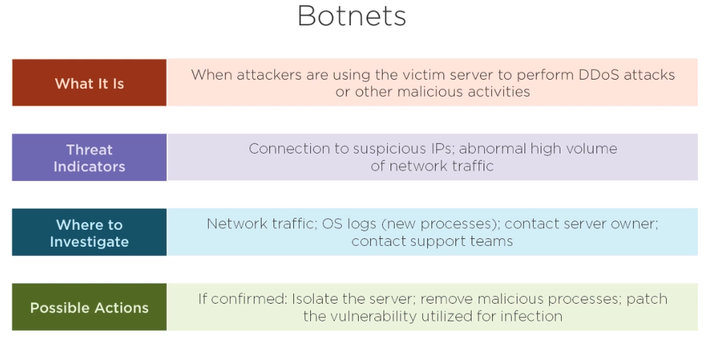

Slide 13
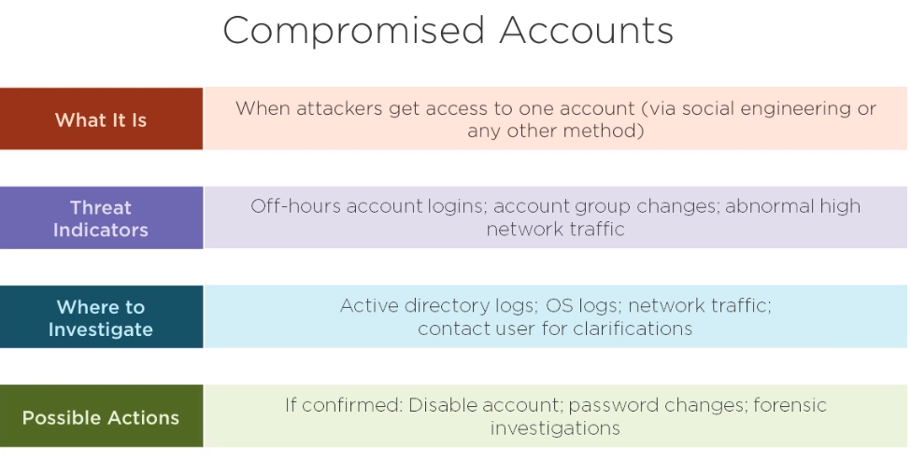

Slide 14
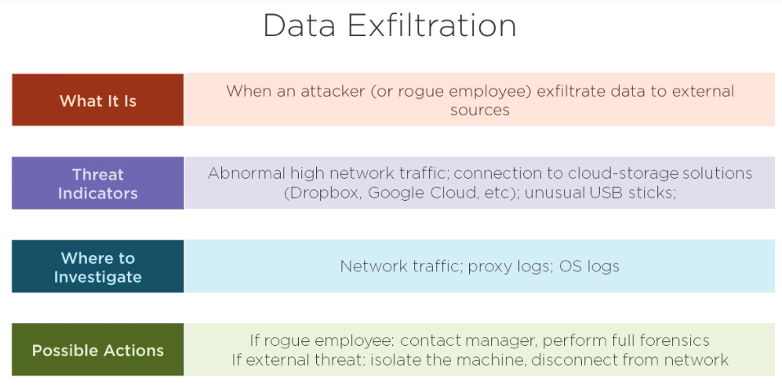

Slide 15
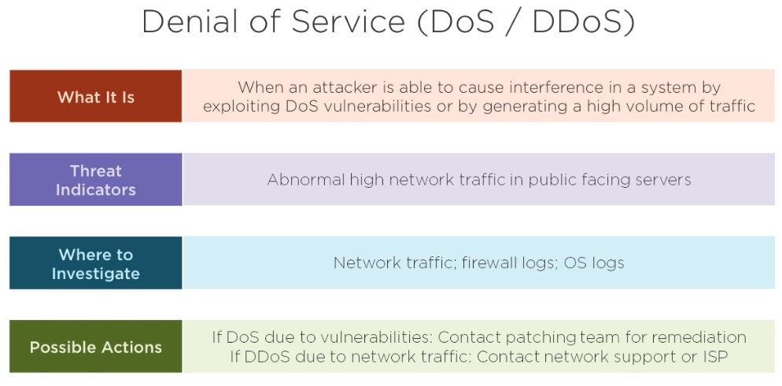

Slide 16
Thank you

